Slide 1


VIZDOME OF THE CROWD
Traffic Volume Prediction
Using Random Forest Algorithm
TEAM NUMBER 9
PRESENTED BY
Satyam Kumar
Sharad Krishna Singh
Shavyam Chitranshi
Yash Jangid
Yashi Kesarwani

Slide 2


Key Steps
Data preprocessing is crucial for model performance.
48,204
Total records processed
Number of entries in the dataset.
Feature transformations applied
85%
Includes hour, day, and weather encoding.
Dropped Data Set
15%
including data-time , holiday , weather description.

Slide 3
Modeling Techniques
Data Splitting
Split dataset into training and testing sets.
Random Forest Training
Train model using Random Forest Regressor on training data.
Model Evaluation
Evaluate performance using MSE and R² metrics.

Slide 4
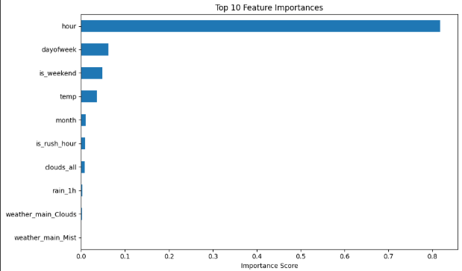
Top Features

Slide 5
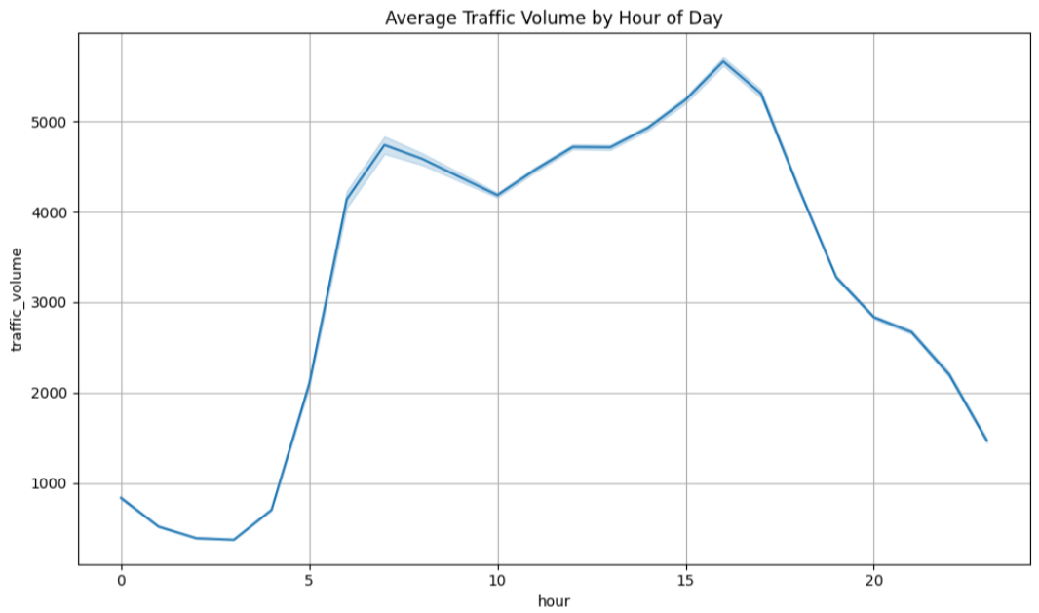
AVERAGE TRAFFIC VOLUME BY HOUR OF DAY

Slide 6
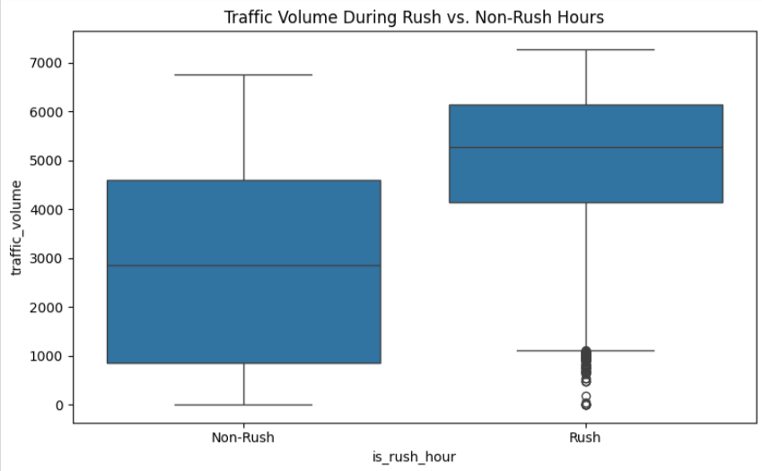
TRAFFIC VOLUME DURING RUSH VS. NON-RUSH HOURS

Slide 7
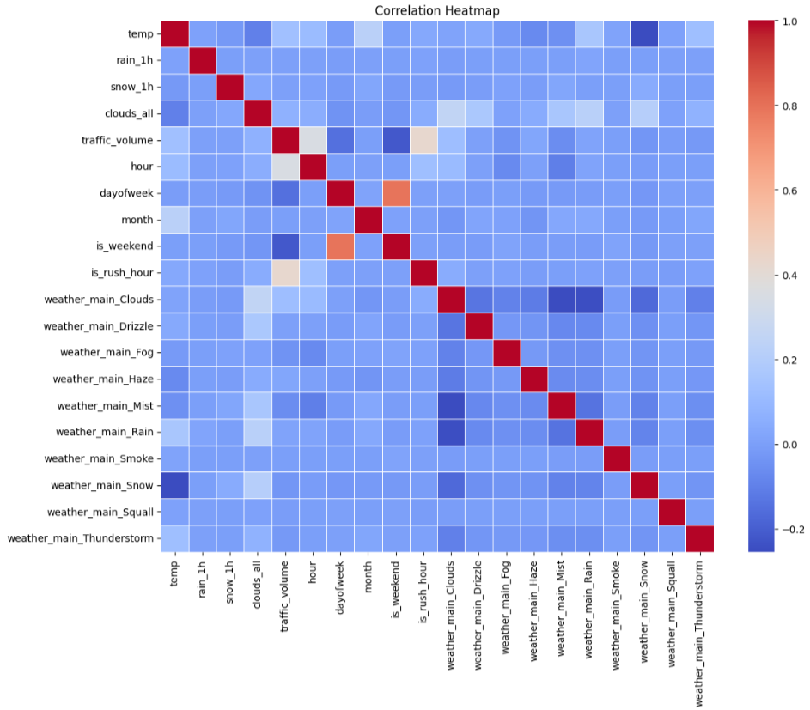
CORRELATION HEATMAP

Slide 8
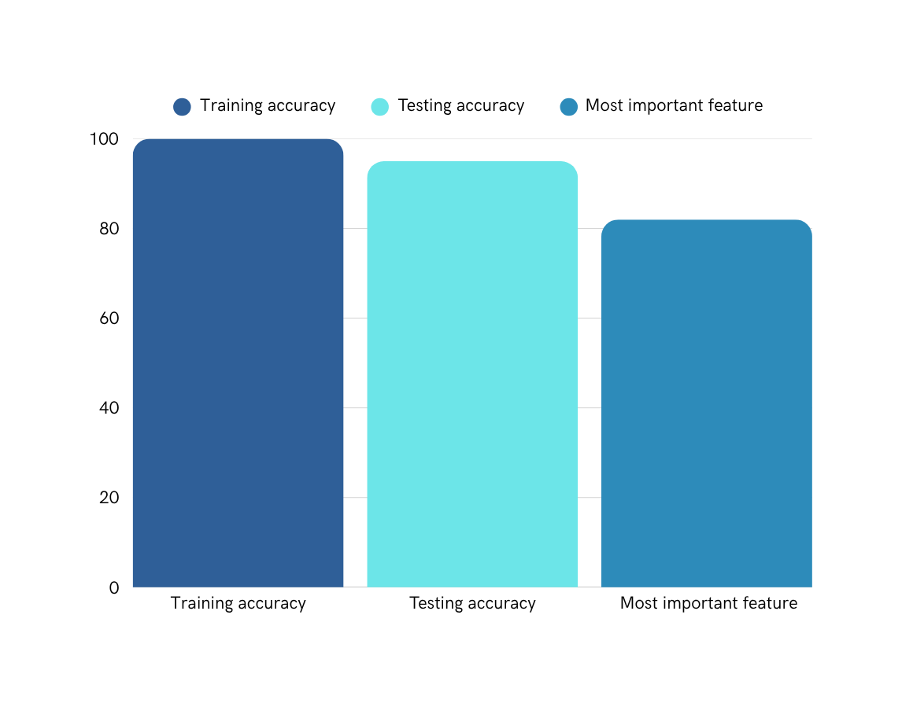
Model Performance Overview
Evaluation Metrics and Feature Importance
The bar chart illustrates key evaluation metrics and feature importances that drive the predictive accuracy of our Random Forest model. Notably, R² scores indicate model performance while highlighting significant factors affecting traffic volume predictions.

Slide 9

Thank you for your attention!

